Slide 1
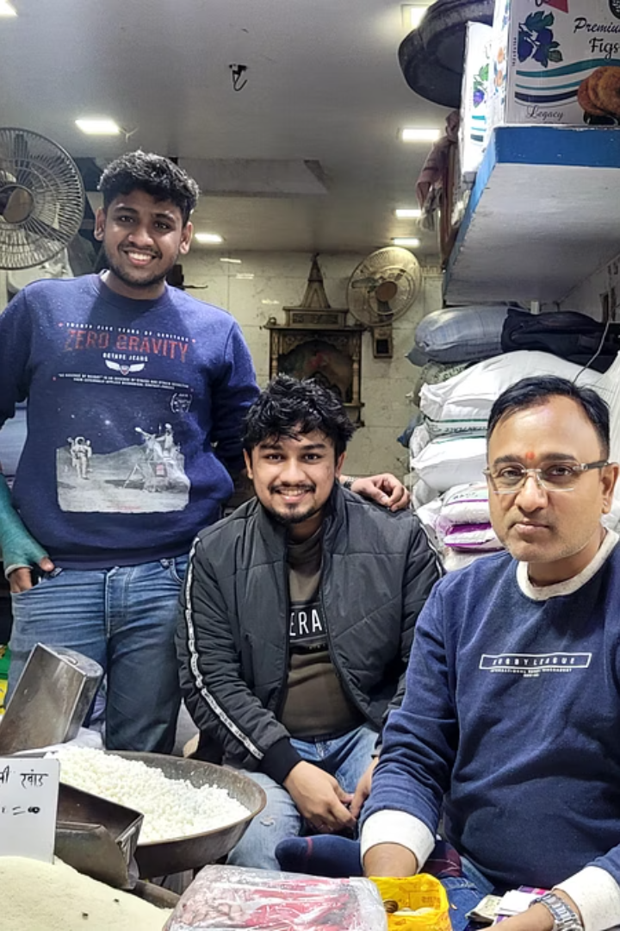

Understanding the Business Purview of a Grocery Firm
Moji Ram Surender Kumar & Company has been a cornerstone of Old Delhi's historic Khari Baoli market since the 1940s. It specialises in traditional Indian grocery items including sugar and essential food products, with a reputation built over generations.
Despite its long-standing presence, the company faces three major challenges:
Inefficient inventory management,
Declining revenue and profit margins
Material wastage.
Our analysis based on daily sales, purchase and inventory data spanning Sep 2024 to Jan 2025 presents data-driven solutions to transform these challenges into sustainable business opportunities, keeping traditional values intact while modernizing operations.
by Rahul Gupta
Roll Number - 22DS2000074

Slide 2

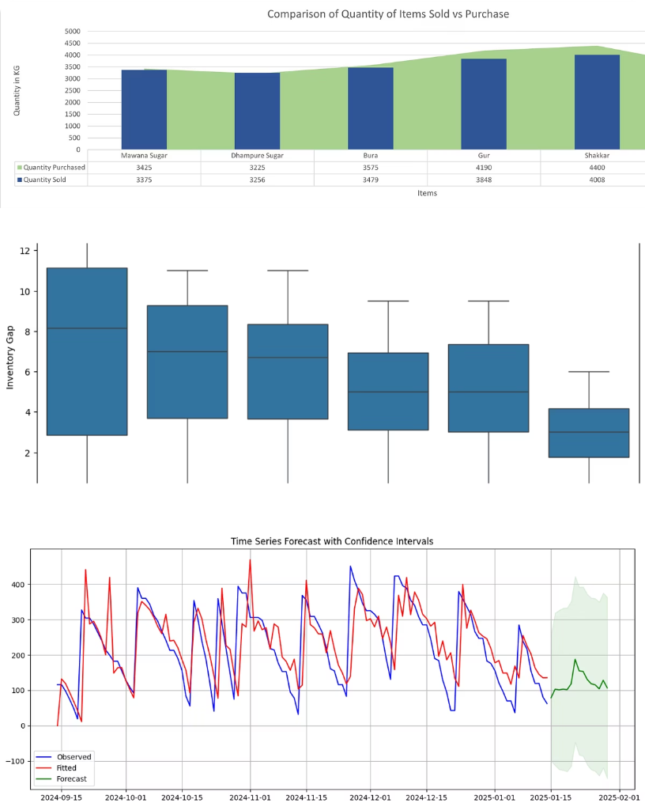
Inefficient Inventory Management - Findings
Our inventory analysis covered daily sales and purchase data from September 2024 to January 2025. Analysis Approach:
Employed a combined area-bar chart to visualize the relationship between purchased and sold quantities
The inventory gap, calculated as the difference between ideal and current inventory levels, was analyzed weekly to identify trends.
Introduced a "Stock Cover" metric to address how quickly stock might deplete. Also analyzed consecutive days with low stock coverage to identify persistent understocking patterns.
Implemented time series forecasting to predict sales quantities with confidence intervals, enabling more informed inventory purchasing decisions.

Slide 3
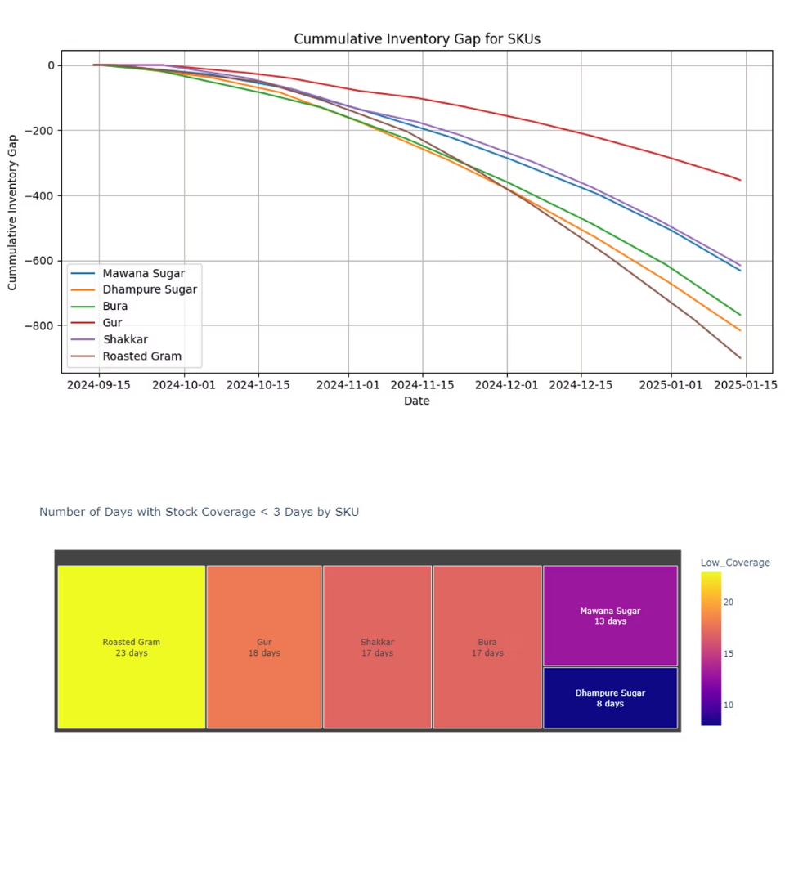
Inventory Insights
Key Findings:
60 KG overall inventory gap by January 2025, indicating systematic understocking
Roasted Gram: Most critical inventory issues with highest frequency of low stock coverage
Stock below critical threshold: Multiple products frequently have less than 3 days of inventory
The financial impact is substantial: insufficient inventory directly connects to lost sales opportunities. Current procurement doesn't align with actual sales demand

Slide 4
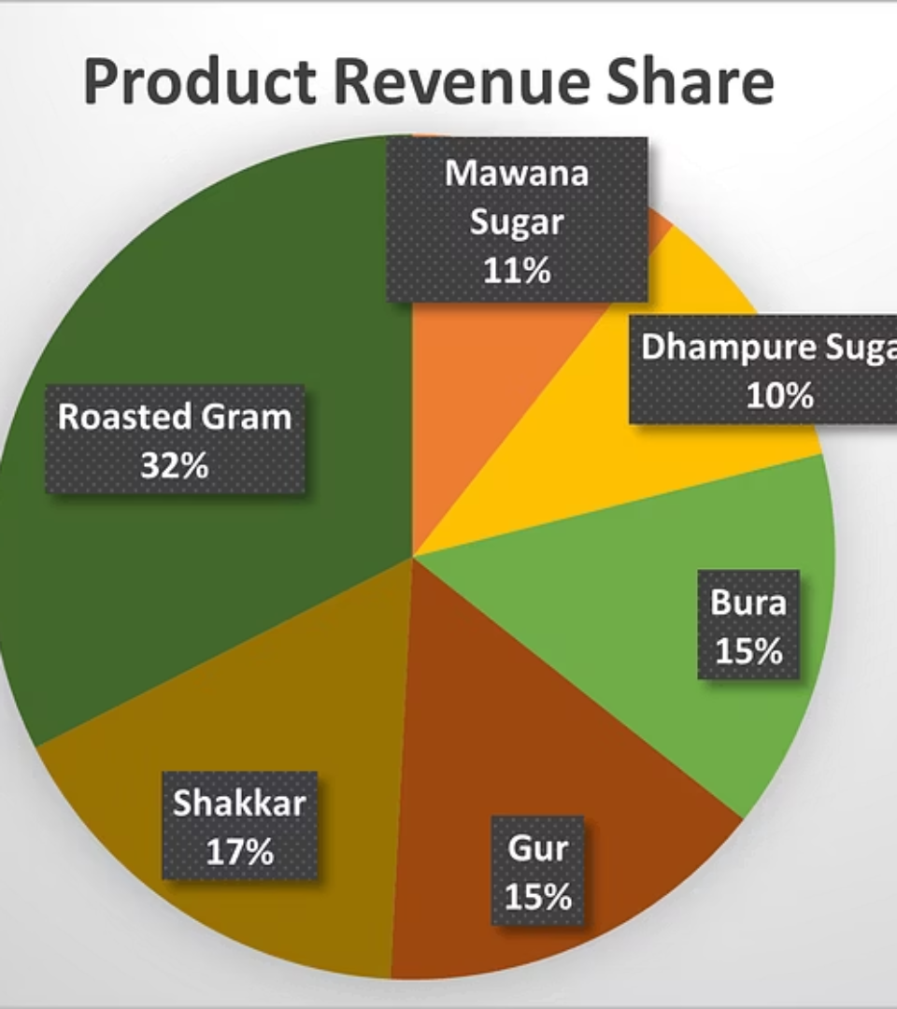
Declining Revenue and Profit Margins
Analysis Approach:
Calculated product-specific revenue contribution and gross profit margins
Implemented Regression Modelling which provides feature importance scores that indicate how much each engineered variable (like Current Inventory, Days Since Last Purchase, etc.) influences the sales outcome.
Assessed viability of online platforms as additional sales channels
Our regression analysis identified key drivers of sales, with selling price and current inventory levels emerging as the most influential factors.

Slide 5

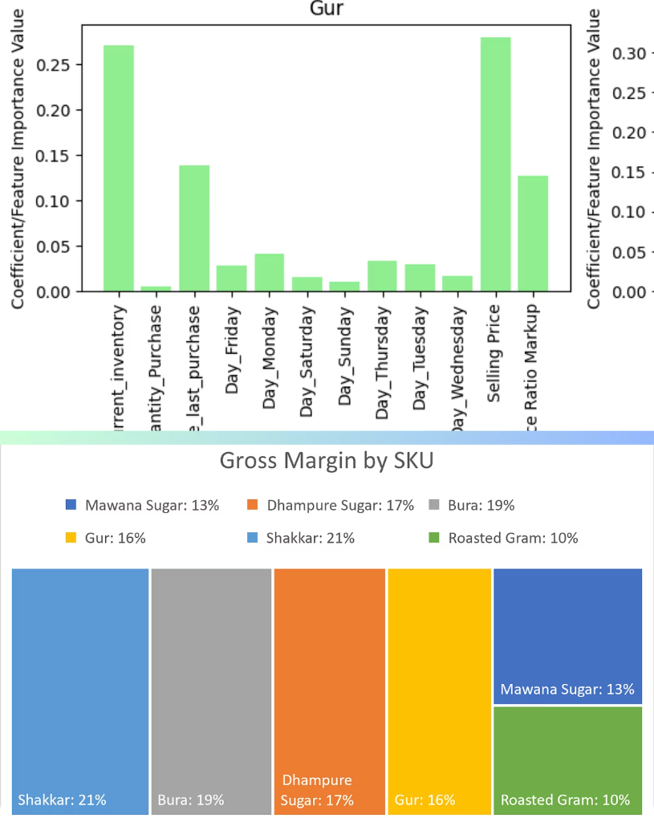
Revenue Insights
The revenue contribution is uneven across the product portfolio.
Roasted Gram: Highest revenue contribution at 19%
Selling price: Single most influential factor in sales performance (29-33% importance)
Current inventory levels: Second most important sales driver (21-27% importance)
Day-of-week effects: Sales patterns vary by product, with specific days showing 2-4% higher importance
Shakkar: Highest gross margin at 16.8%
Bura: Second highest at 14.7%
Dhampure Sugar: Lowest margin at 5.5%
Significant profitability variation suggests pricing strategy opportunities
Roasted Gram contributes the highest revenue share, while sugar variants show minimal contribution despite requiring significant shelf space and investment but still Roasted Gram stands last when it comes to profit margins.

Slide 6

E-Commerce Opportunity Assessment
Platform fees: Range from 5-15% depending on product category
Product viability: High-margin products (Shakkar, Bura) can absorb platform fees
Price adjustments needed: Current prices for Dhampure Sugar and Mawana Sugar would need increases of 12-15% to maintain margins online

Slide 7

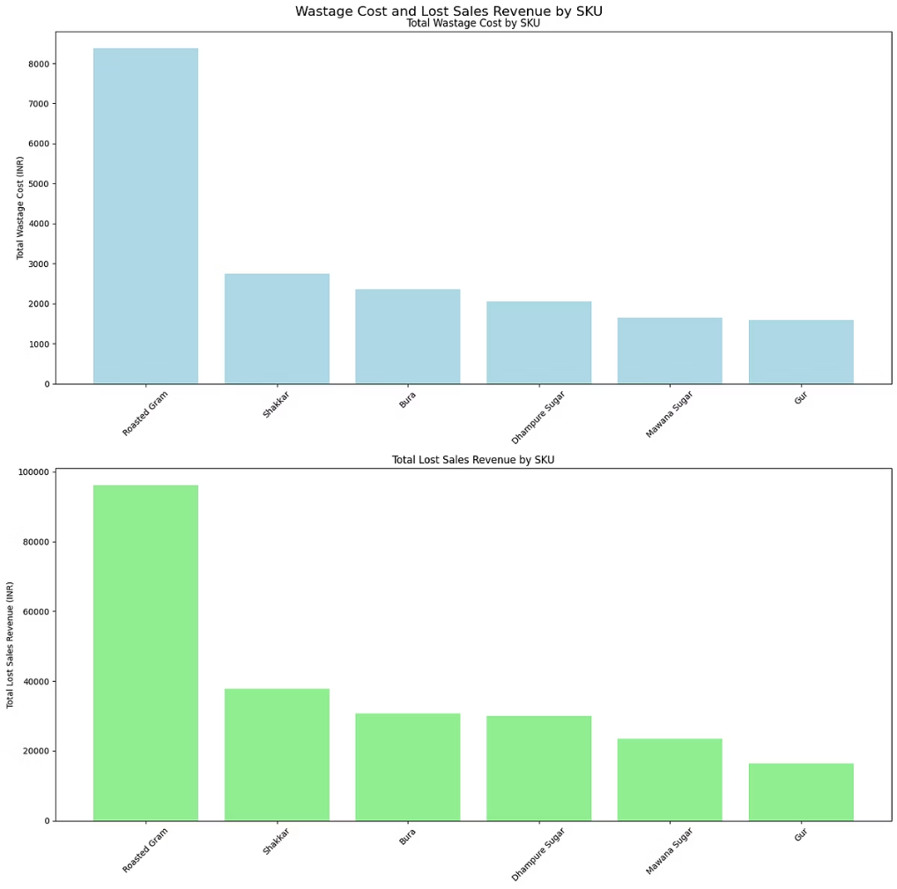
Material Wastage
Our wastage analysis calculated both the direct cost from spoilage and damage, and the opportunity cost due to lost sales from stockouts. Patterns were examined to understand root causes by product and over time.
Analysis Approach:
Calculated direct wastage costs based on inventory gaps
Estimated lost sales revenue from understocking
Analyzed wastage patterns by product and over time
Identified root causes of material losses

Slide 8

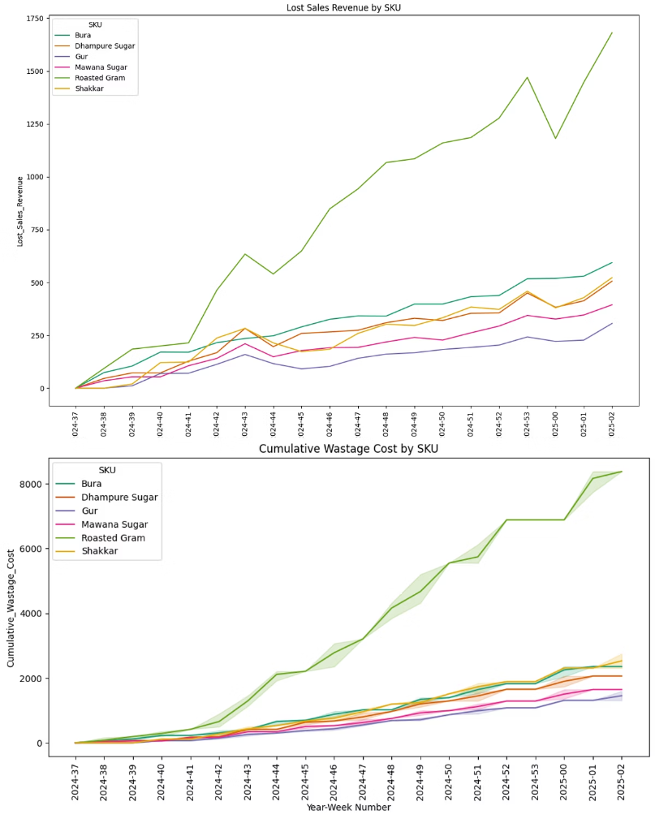
Wastage Insights
Roasted Gram emerges as the largest contributor to both direct wastage costs and lost sales revenue. Wastage accumulates gradually, reflecting ongoing handling and storage inefficiencies rather than isolated incidents.
Storage and handling protocols currently amplify wastage and require systematic overhaul.
Consistent Product Understocking
Storage Practices
Contribute significantly to physical product damage
Causes ongoing lost sales and increased spoilage risks
Opportunity Cost
Wastage directly drains profit margins

Slide 9

Recommendations
Inventory Management:
Revenue Enhancement:
Wastage Reduction:
Implement data-driven forecasting using identified seasonal patterns
Adjust pricing for low-margin products (particularly Dhampure Sugar)
Implement First-In-First-Out inventory protocol
Reduce handling damage through standardized procedures
Establish SKU-specific minimum stock levels
Optimize product mix based on margin contribution
Track waste by cause to enable targeted reductions
Prioritize inventory improvements for Roasted Gram
Launch online sales with Roasted Gram and high-margin products

Slide 10
The Path Forward
Implementing these recommendations will deliver immediate reductions in stockouts and lost sales by stabilising inventory levels. Medium term, the business can expect a 15-20% cut in wastage costs through improved practices.
Long-term success hinges on optimising the product mix and pricing strategies to enhance profitability while preserving the company’s heritage. These steps promise revitalisation and growth for Moji Ram Surender Kumar & Company in a competitive market.
15-20%
₹96K
3
Wastage Cost Reduction
Lost Sales Recoverable
Key Challenges Addressed
Projected medium-term improvement
From inventory optimisation on key products
Inventory, revenue, and wastage

Slide 11
Thank You
Thank you for your attention and time. Looking forward to any questions you may have.

